Slide 1
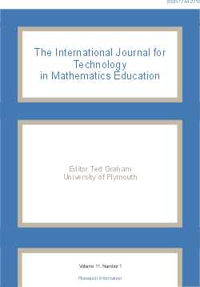
CADGME 2009 Conference and IJTME
Carrie Headlam
Centre for Teaching Mathematics
University of Plymouth

Slide 2
Two Special Issues in 2010
Volume 17, Numbers 3 and 4
One Dynamic Geometry
Computer Algebra
Guest editors: Zsolt Lavicza and Sárvári Csaba

Slide 3
Submission of Papers
Scientific Committee will select 20 papers from the CADGME Conference sessions.
Of these 16 papers will appear in the special editions.
Any others will appear in later editions.
Maximum of 6 IJTME pages per paper.
Approximately 4000 words.
An electronic template is available.

Slide 4
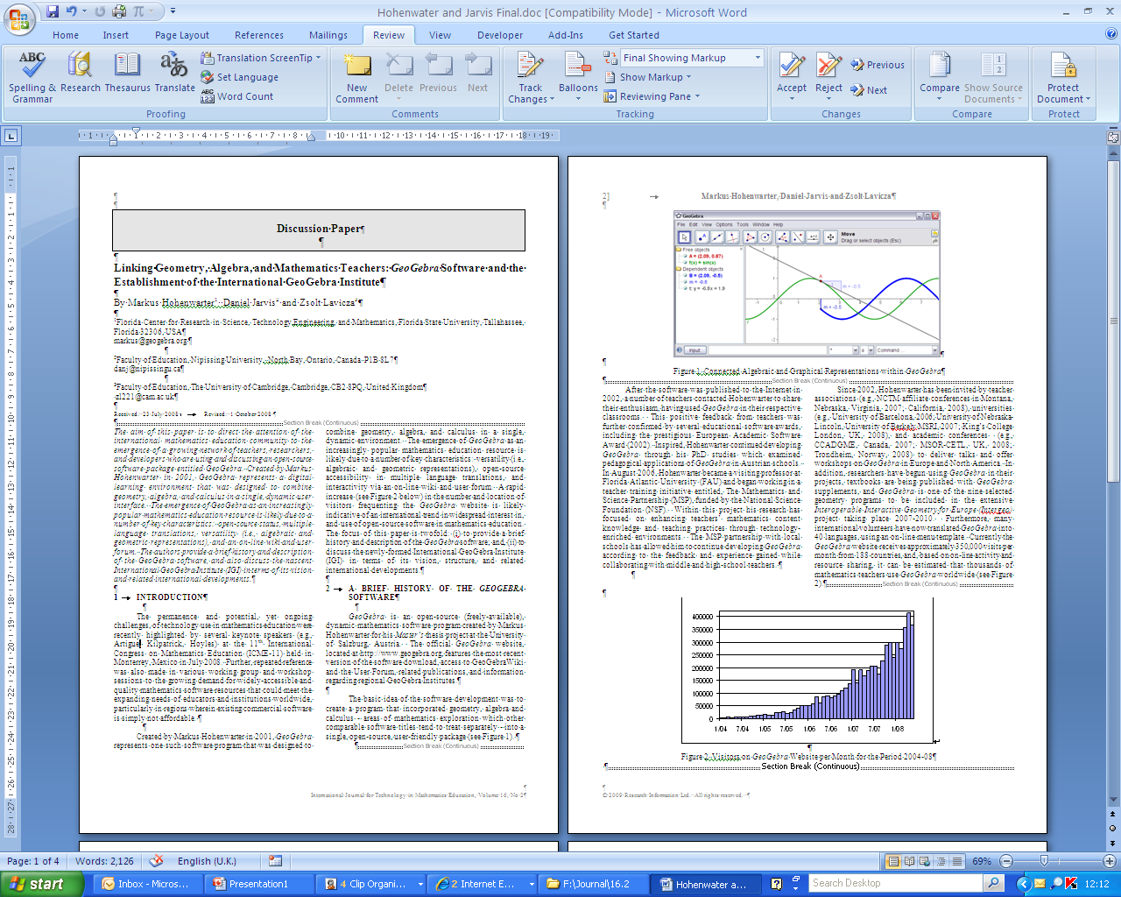
Submission of Papers

Slide 5
Types of Paper
Research Papers
Ideas for Teaching and Learning
Discussion
Write papers to aim for one category.

Slide 6
Special Issue Schedule 1
1st August Invitations sent out by Scientific Committee
15th September 2009 Papers submitted via Easy Chair and sent on to referees (Scientific Committee)
1st November 2009 Revision requests sent out to authors
15th December 2009
Revised papers submitted

Slide 7
Special Issue Schedule 2
1st February 2010 Publication Confirmed / Further work requested
15th March 2010 Final submission
September 2010 First Special Issue Published
December 2010 Second Special Issue Published

Slide 8
IJTME Information
CADGME Website
CTM, University of Plymouth http://www.tech.plym.ac.uk/research/mathematics_education/field%20of%20work/IJTME/index.htm
Research Information
http://www.researchinformation.co.uk/time.php

